Slide 1

HOME LOAN APPROVAL PREDICTION
By: Sajeevan Kumarasamy

Slide 2

INTRODUCTION
Dream housing company provide home loan facility across all urban, semi urban and rural areas
The company wants to automate the loan eligibility process in real time based on the customer details provided while apply online
The details such as Gender, Marital Status, Education, Number of Dependents, Income, Loan Amount, and Credit History
A data set consists of customer information collected was used to predict the customer segment who are eligible to get home loan
Various visualization techniques and methods will be used to identify the pattern and behaviors’ of potential customers

Slide 3

DATA HANDLING PROCESS
Set the objectives
Set the objectives
Import the Data
Identify the problem
Import the Data
Identify the problem
Identify the problem
Analyse the Data
Clean the Data
Visualization
Model the data
Evaluation

Slide 4

OBJECTIVES
Descriptive Objectives
Univariate Analysis on Demographic factors, socio-economic factors and loan related factors
How Demographic factors such as Gender, Marital status and number of dependents affect loan eligibility?
How socio-economic factors such as Education, employment status and income affect loan eligibility?
How Loan amount, Lona term, Credit history and Property area affect loan eligibility?
Predictive Objectives
Fit the model to predict the home loan eligibility in real time while customer provide details in online form

Slide 5
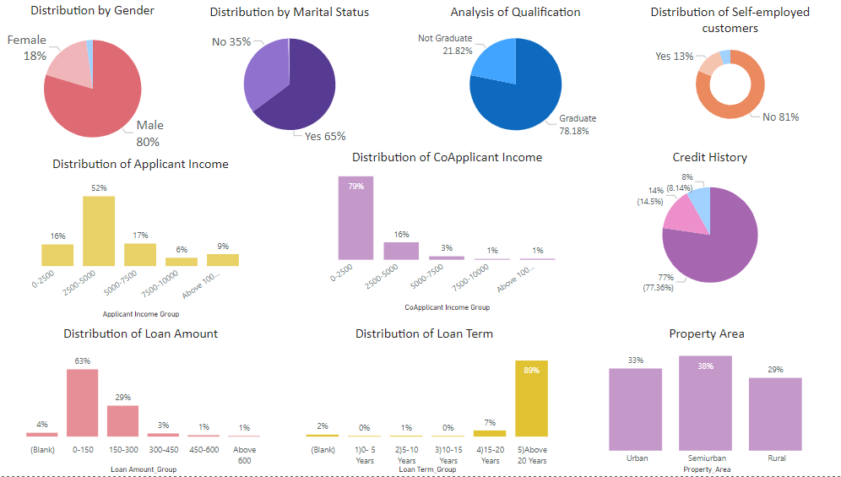
OVERVIEW
Demographic Factors
80% of the applicants are male, 65% of applicants are married
Socio-Economic Factors
78% of the applicants are Graduate, only 13% of them are self-employed, and 52% of the applicants’ income falls between 2500 and 5000
Loan related Factors
77% of the applicants have credit history, 89% of the applicant loan repayment term is more than 20 years and there is no significant difference in property area

Slide 6
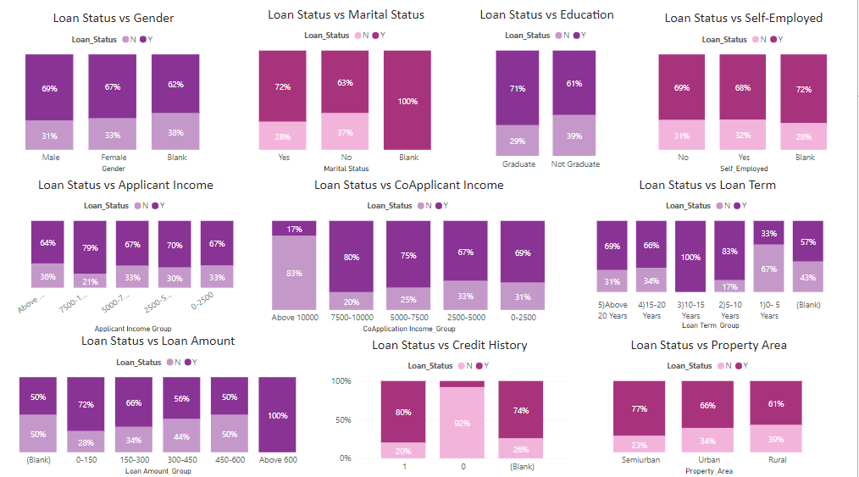
RELATIONSHIP WITH LOAN ELIGIBILITY
Demographic Factors
Gender has no impact on loan eligibility, Married applicants have more chance to eligible for home loan
Socio-Economic Factors
Graduate has more chances to get loan compared to non-graduates and employment type has no impact on eligibility.
Loan related Factors
The chances are higher to eligible for home loan if the loan term is more than 5 Years. If the applicant has a credit history 80% of the times they will be eligible for loan

Slide 7
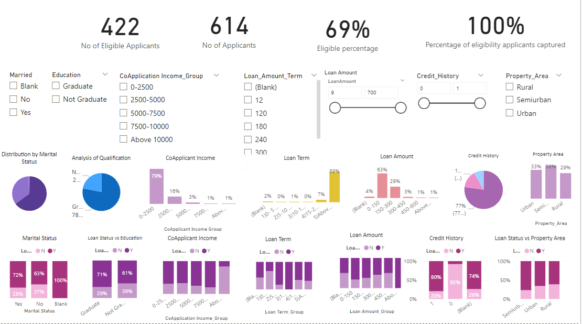
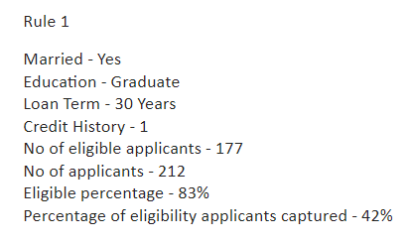
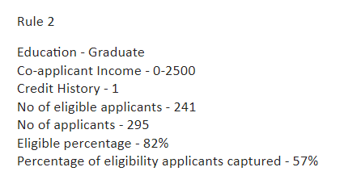
SIMULATOR
The potential rules have been defined by using the simulator in Power BI

Slide 8
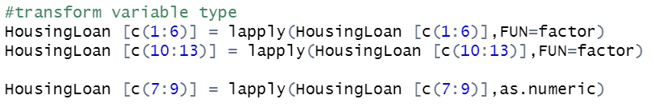

DATA CLEANING PROCESS
Import the data: R studio has been used for data cleaning
Transform categorical and numeric variables
Factorize categorical variables
Transform variables to numeric
Duplicate removal approach: No duplicates found in the data set

Slide 9
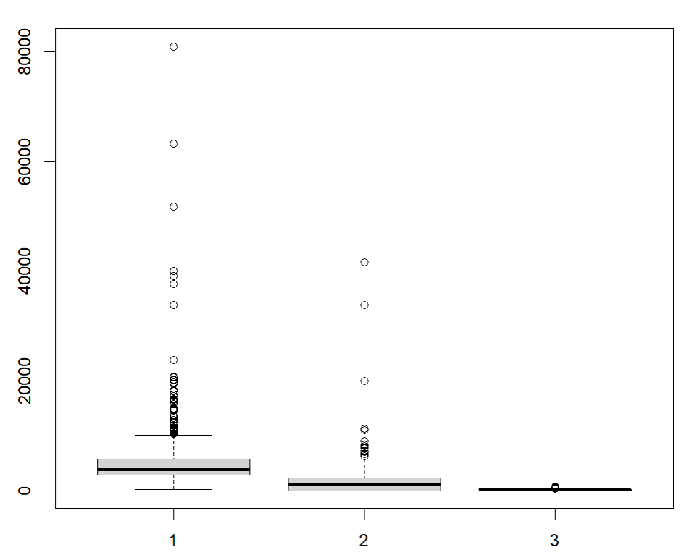
DATA CLEANING PROCESS
Outlier Treatment:
Box plot was used to identify which variables has outliers
The variables Applicant income, Co-applicant income and loan amount have outliers

Slide 10
DATA CLEANING PROCESS
The below two approaches has been considered to treat the outliers
Delete the outliers: Delete the entire records of the outliers. This cannot be performed as the numbers of data for the analysis massively reduce which may cause biasness
Replace the outliers with mean: Outliers have been replaced with mean

Slide 11

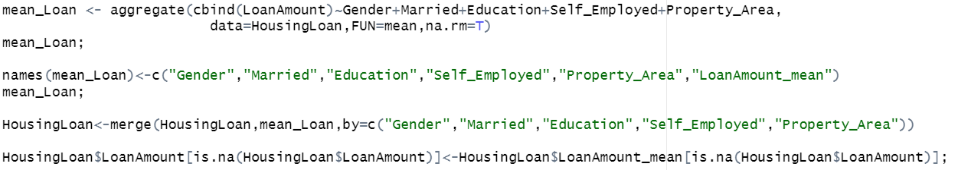
DATA CLEANING PROCESS
Missing Value Treatment
Categorical Variables: Mode Imputation is used to treat missed values of categorical variables
Numeric variable: Replace missing values with mean

Slide 12
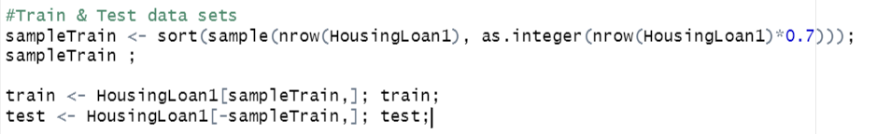
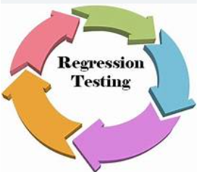
HOME LOAN ELIGIBILITY PREDICTION MODEL
Logistic regression was modelled to predict the customers who are eligible for Home loan
The data set has been divided randomly in to two sets as Train and Test by 70% and 30% respectively
Train data set was used to model and the test data set was used to test the model for accuracy
Using this model eligible applicants can be identified to get the home loan in real time

Slide 13
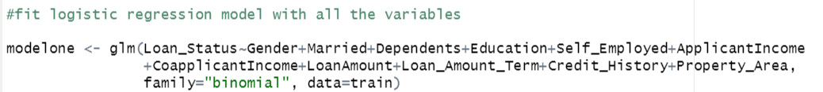
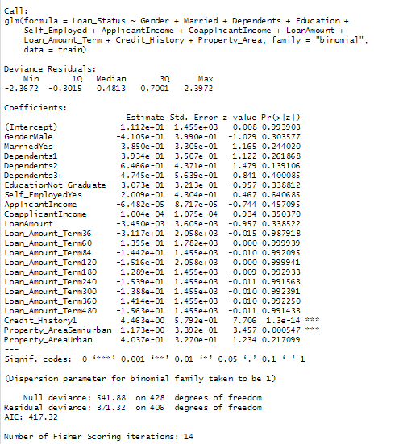
HOME LOAN ELIGIBILITY PREDICTION MODEL
Initially all the variables were used for modelling
Variables which has lower p-value were selected for model 2
McFadden R was calculated for the fitted model to check the accuracy of the fitted model

Slide 14
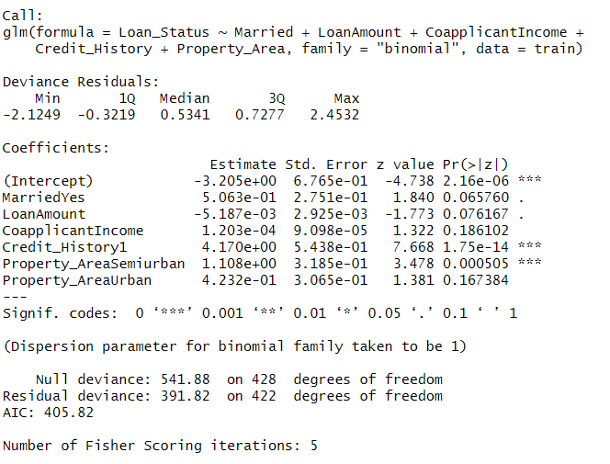

HOME LOAN ELIGIBILITY PREDICTION MODEL
Variables which has lower p-value were selected for model 2
McFadden R was calculated for the fitted model to check the accuracy of the fitted model

Slide 15
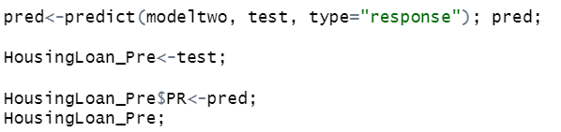
HOME LOAN ELIGIBILITY PREDICTION
Test data set was used to predict the home loan eligibility using the above fitted logistic regression
Prediction form the model and the loan eligibility status from the data set was analyzed to see the accuracy of the model

Slide 16
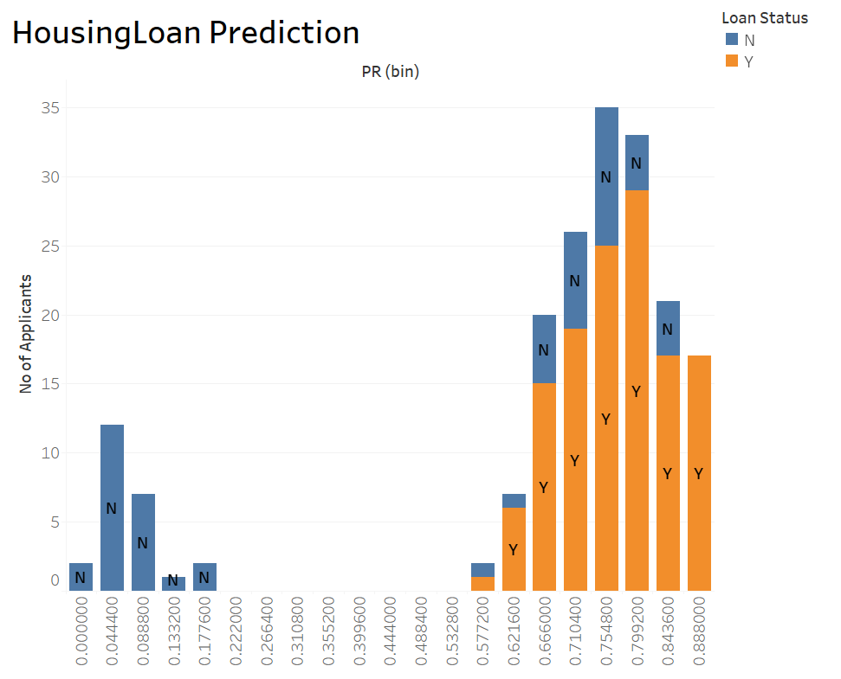
ELIGIBILITY PREDICTION
Prediction value from model
Test data set was used to predict the applicant’s eligibility for home loan using the above fitted logistic regression
Predicted eligibility and the customer category was analyzed
If the prediction is greater than 0.621 the chances to get eligibility is high

Slide 17
SUMMARY
Gender , applicant income and self-employed have no impact on loan eligibility.
Married graduates who have 30 years loan term higher chance to get loan eligibility.
Applicants who have credit history higher chance to get loan eligibility.
It concluded that the fitted model can be used to predict the loan eligibility.

